Slide 1
software
/ˈsɒf(t)wɛː/
noun
the programs and other operating information used by a computer.

Slide 2
SOFTWARE
Software is a set of instructions or programs instructing a computer to do specific tasks.

Slide 3
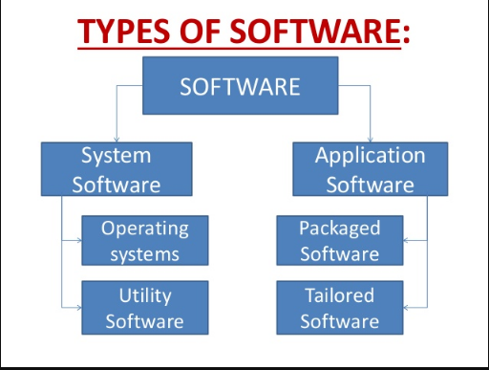

Slide 4
SYSTEM SOFTWARE
System software is computer software designed to operate and control the computer hardware and to provide a platform for running application software.

Slide 5
UTILITY SOFTWARE
Utility software is a system software designed to help to analyze, configure, optimize or maintain a computer.
Examples: antivirus software, backup software and disk tools.

Slide 6
APPLICATION SOFTWARE
Application software (app for short) is software designed to perform a group of coordinated functions, tasks or activities for the benefit of the user.

Slide 7
PACKAGED SOFTWARE
Packaged software is a collection of programs that perform similar functions or have similar features.
For example, Microsoft Office includes multiple applications such as Excel, word and power point.

Slide 8
TAILORED OR CUSTOM SOFTWARE
A particular program that gets developed for one purpose within a company or department.

Slide 9
ENGINEERING
engineering
/ɛndʒɪˈnɪərɪŋ/
noun
the branch of science and technology concerned with the design, building, and use of engines, machines, and structures.

Slide 10
SOFTWARE ENGINEERING
Software engineering is an engineering branch associated with development of software product using well-defined scientific principles, methods and procedures. The outcome of software engineering is an efficient and reliable software product.

Slide 11
ACCORDING TO IEEE
The application of a systematic, disciplined, quantifiable approach to the development, operation, and maintenance of software; that is, the application of engineering to software.

Slide 12
ADVANTAGES
Improves Quality
Better Requirement Specification
Improves Cost and schedule estimate
Better Use of Automated Tools and Techniques
Better Maintenance of Delivered Software
Well Defined Process
Improves Reliability
Improves Productivity
Less Error

Slide 13
PRINCIPLES
Divide and conquer
Understand the use of abstraction
Strive for consistency
Focus on the transfer of information
Build software that exhibits effective modularity
Look for patterns
When possible, represent the problem and its solution from a number of different perspectives.
Remember that someone will maintain the software

Slide 14
CHARACTERISTICS OF SOFTWARE
Functionality
Reliability
Usability
Efficiency
Maintainability
Portability

Slide 15
Functionality
Suitability
Accuracy
Interoperability
Compliance
Security

Slide 16
Reliability
Recoverability
Fault Tolerance
Maturity

Slide 17
Usability
Understandability
Learnability
Operability

Slide 18
Efficiency
In Time
In Resource

Slide 19
Maintainability
Testability
Stability
Changeability
Operability

Slide 20
Portability
Adaptability
Installability
Replaceability

Slide 21
SDLC
Software Development Life Cycle

Slide 22
Introduction
The SDLC is a framework that describes the activities performed at each stage of a software development project.
SDLC process is used by the software industry to design, develop and test high quality software.
It aims to produce the quality software that meets or exceeds customer expectations, reaches completion within time and budget.

Slide 23
ISO/IEC 12207 is an international standard for software life-cycle processes. It aims to be the standard that defines all the tasks required for developing and maintaining software.
Software Engineering Process Technology Company, (SEPT) is a firm specializing in meeting the software process standards information needs of the professional community, particularly concerning ISO/IEC 12207.

Slide 24
Phases in SDLC
PLANNING
ANALYSIS
DESIGN
CODING
TESTING
MAINTENANCE

Slide 25
Planning
Review project requests
Prioritize project requests
Allocate resources
Identify project development team

Slide 26
Analysis
Conduct preliminary investigation
Perform detailed analysis activities:
Study current system
Determine user requirements
Recommend solution

Slide 27
Design
software design documents are prepared as per the requirement specification document.

Slide 28
CODING
“Let’s create what we want.”
Actual development starts.

Slide 29
TESTING
“Did we get what we want?”
This is done to verify that the entire application works according to the customer requirement.

Slide 30
MAINTENANCE
Bug fixing - bugs are reported because of some scenarios which are not tested at all
Upgrade - Upgrading the application to the newer versions of the Software
Enhancement - Adding some new features into the existing software

